Slide 1
Registered Medical Assistant at BCCC
YOU BELONG HERE

Slide 2
RMA is a member of the healthcare profession. RMA will perform clinical and administrative duties under the direction of a medical provider. Clinical duties may include taking and recording vital signs and medical histories, preparing patients for examination, drawing blood, and administering medications as directed by medical provider. Administrative duties may include scheduling appointments, maintaining medical records, billing, and coding information for insurance purposes.
What is a Registered Medical Assistant, RMA?
Registered Medical Assistant, RMA versus Certified Medical Assistant, CMA
RMA is a certificate program. CMA is a diploma program. Duties and pay are often the same.
Video by Mikhail Nilov

Slide 3
Employment Opportunities
Hospital-(clerical)
Primary Physician Clinic
Outpatient Clinic
*Specialty Healthcare Clinics-Pediatric, Gastroenterology, OB-GYN, Urgent Care, and Dermatology
NC average starting pay rate is $14/hr.
*Not all inclusive
Video by cottonbro

Slide 4
Registered Medical Assistant-Let’s get started
Prerequisites: Career Readiness Certificate (CRC) of Bronze or Higher, High school transcript or High School Equivalency Other options: College degree, or a Math and English college course with at least a C.
CRC link for more information-BCCC NCRC Testing Information
Register in Building 8. Payment and prerequisites are due at the time of registration. Financial/scholarship assistance may be available. Call 252-940-6375
Registration and Payment
Financial Assistance
Program requirements are discussed in detail on the first day of class.

Slide 5
Program Requirements
Hybrid course with online instruction. Student will need to be able to access Blackboard and attend in person for class, lab and clinical instruction.
Student is responsible for: books, background check, immunizations, drug testing, and transportation to clinical site(s).
Part II requires 160 hours of clinical experience at a clinical facility. Clinical facilities require a background check, drug testing, and current immunizations. (MMR, Varicella, 2-step TB, TDAP, COVID, Flu, Hep B, CPR)
Students is responsible for purchasing CastleBranch. CastleBranch is a 3rd party vendor used for background check, drug testing and immunization documentation ($90). Convictions or unsubstantiated drug tests are reviewed and determined by the clinical facility. Clinical facility decision is final.
Student is responsible for purchasing Rotation Manager. Rotation Manager ensures student compliance with clinical facility. ($29)
Student is responsible for ensuring immunizations are up-to-date. Cost will vary depending on immunizations needed.
Uniform: Price will vary depending on your place of purchase.
https://discover.castlebranch.com/
https://rotationmanager.com/

Slide 6
RMA Credentialing
v
Individuals completing the RMA Program are encouraged to take a national certification exam.
ASPT is a National Certifying Agency.
https://americanmedtech.org/

Slide 7
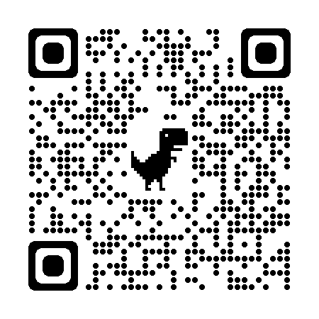
Registered Medical Assistant Part I- Registration-$180, Course fees-$5 Part II- Registration-$180, Course fees-$24.25 Contact Continuing Education for Scholarship Information
Continuing Education
252-940-6375 or 252-940-6263
Email: continuingeducation@beaufortccc.edu
jackie.butcher@beaufortccc.edu
Listed below are links to our website to assist you.
Registration and Payment
Financial Assistance
Class Schedules

